Slide 1





ASP.NET State Management
Session State, Application State, View State
Svetlin Nakov
Telerik Software Academy
academy.telerik.com

Slide 2

Table of Contents
ASP.NET Intrinsic Objects
State Management in Web Applications
Cookies
Hidden Fields
Parameterized Addresses
ASP.NET State Management
Client side – View State
Server side – Application State, Session State
Manipulating the HTTP response headers

Slide 3



Intrinsic Objects in ASP.NET
Session, Application, Request, Response, …

Slide 4
Intrinsic Objects in ASP.NET
Intrinsic objects in ASP.NET are available in the context of any Page or Control
Application (HttpApplication class)
Session (HttpSession class)
Request (HttpRequest class)
Response (HttpResponse class)
Server (HttpServerUtility class)
Context (HttpContext class)
Cache (System.Web.Caching.Cache class)

Slide 5

HttpApplication
HttpApplication keeps the application state
Provides access to other intrinsic objects
Properties Application, Context, Request, Response, Server, Session etc.
Provide events for:
Start of a new request
Authentication
Authorization
Working with the cache
End of a request

Slide 6
HttpRequest
HttpRequest contains information about the current HTTP request (Request object)
ApplicationPath – root path on the server
Browser – type, platform, capabilities, etc.
Cookies – get the cookies collection
HttpMethod – GET / POST
QueryString – e.g. ?id=7&lang=en
ServerVariables – IIS server settings
Url – the requested URL

Slide 7
HttpResponse
HttpResponse contains information about the HTTP response (Response object)
ContentType – MIME type (e.g. image/gif)
Charset – response encoding, e.g. UTF8
Cookies – sets cookies
Expires – sets browser's cache expiration
BufferOutput – buffer or not the response
ClearHeaders(…), AddHeader(…)
Write(…), BinaryWrite(…), WriteFile(…) – send text or binary data to the client

Slide 8
HttpServerUtility
HttpServerUtility – helper methods for processing HTTP requests (Server object)
HtmlEncode(…) – escapes given HTML, e.g. "<img>" → "&lt;img&gt;"
HtmlDecode(…) – un-escapes escaped HTML
UrlEncode(…) – encode string for the browser URL, e.g. "+.net 4" → "%2B.net+4"
UrlDecode(…) – decode url-encoded string
MapPath(…) – returns the server-side path for given resource given as relative path

Slide 9
Intrinsic Objects – Examples
bool isSecureConnection = Request.IsSecureConnection;
Application.Add("key", "value");
LabelResult.Text = Server.UrlEncode("Did you try ASP.NET 4.0?");
Response.ContentType = "text/html";
Response.Charset = "UTF-8";
string imageFileName = Server.MapPath("img/logo.gif");
string url = Request.Url;
string browserType = Request.Browser.Type;

Slide 10

Intrinsic ASP.NET Objects
Live Demo

Slide 11
Redirecting to Another URL
Response.Redirect("Login.aspx")
Client-side redirection (uses HTTP 302 Moved)
Asks the browser to request a new URL
Changes the URL address in the browser
Server.Transfer("WebTest.aspx")
Server-side redirection
Keeps the URL in the browser
The browser does not even know about the redirection

Slide 12




Client and Server Redirection
Live Demo

Slide 13

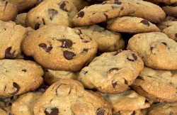

State Management: Standard Mechanisms in Web Applications
Cookies, Hidden Fields, Parameterized Addresses

Slide 14
State Management in Web Applications
The HTTP protocol is stateless
No built-in way to implement a stateful interaction (session / conversation)
Preserving state between the HTTP requests:
Cookies (used by the ASP.NET session)
Hidden fields (used by the ASP.NET ViewState)
HTML5 local storage / session storage
Parameterized addresses (used to implement cookieless session in ASP.NET)

Slide 15
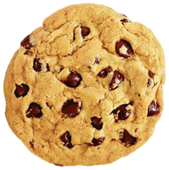
What is a Cookie?
A small piece of information (up to 4KB)
Sent to a browser by the Web server
Saved locally at the client as a text file
Sent by the browser in all subsequent requests
Sent as an HTTP header
HTTP Response:
Set-Cookie: UserID=baj.ivan; path=/; domain=nakov.com; Expires=Wed, 14 Jun 2015 10:18:14 GMT
HTTP Request:
Cookie: UserID: baj.ivan;

Slide 16
Cookie Properties
Cookies is ASP.NET are represented by HttpCookie objects
Expires
Sets when the validity of the cookie expires
Domain
A domain to which the cookie belongs
Path
Sets the root directory of the cookie
Secure – transmit over encrypted channel
HttpOnly – no JavaScript access

Slide 17

Working with Cookies
For Web applications
System.Web.HttpCookie
For client applications
System.Net.Cookie
HttpRequest.Cookies contains the cookies received by the server
HttpResponse.Cookies contains the cookies sent to the client

Slide 18
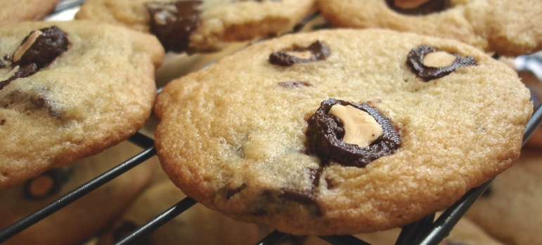
Working with Cookies – Example
Creating a cookie that will be sent to the client Web browser:
Reading a cookie received at the server:
HttpCookie cookie =
new HttpCookie("UserName", "baj.ivan");
Response.Cookies.Add(cookie);
HttpCookie cookie = Request.Cookies["UserName"];

Slide 19
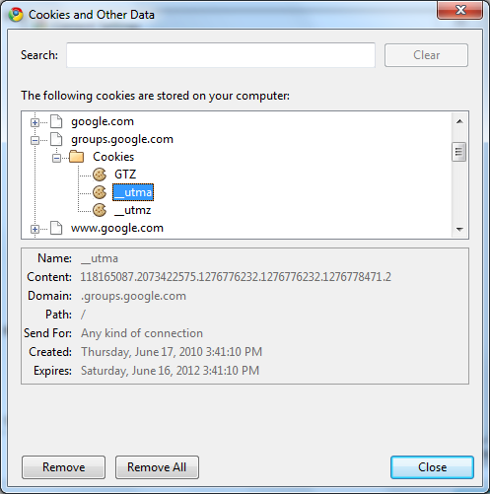


Cookies
Live Demo

Slide 20
What are Hidden Fields?
Hidden form fields keep information, not visible in the Web page, sent on form submit
ASP.NET HiddenField is a control, which renders as a standard HTML hidden field
Not visible in the browser, but you can use it to store information directly in the page
Insecure, because malicious user can easily access hidden fields and tamper it
ASP.NET ViewState is encrypted for security
<input type="hidden" name="Language" value="English">

Slide 21
Local Storage / Session Storage
HTML5 provides client-side local and session storage (through JavaScript)
localStorage – stores data long term
sessionStorage – stores data for one session
Local data is stored per domain
E.g. academy.telerik.com and nakov.com have different storages
localStorage.setItem('myColor', 'red');
var color = localStorage.getItem('myColor'); // -> 'red'
localStorage.removeItem('myColor');

Slide 22
Parameterized Addresses
Also known as query strings
Setting the parameters in the URL of a page after the "?" sign:
Reading a query parameter:
Used to pass data from one page to another
Insecure, because malicious user can copy or change the address
http://asp.net/getstarted/default.aspx?tabid=61
string selectedTabID = Request.QueryString["tabid"];

Slide 23
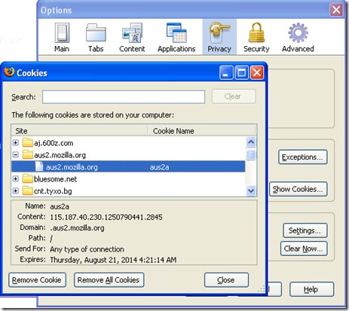

ASP.NET State Management

Slide 24
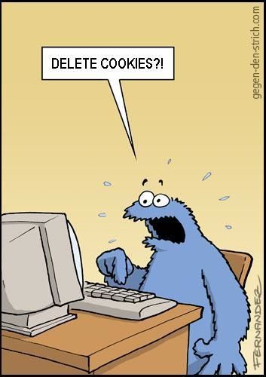
ASP.NET Based State Management
Client side state
View state
Server side state
Application state
Session state

Slide 25



ASP.NET Client Side State Management
ViewState

Slide 26
ViewState
ViewState keeps the state of the controls over several consecutive requests to the same page (postbacks)
Every change in the visualization of a control is saved in the ViewState
E.g. adding an element to a list control
Can save custom data defined by developers
ViewState["Username"] = txtUsername.Text.Trim();
lblUsername.Text = (string) ViewState["Username"];

Slide 27
ViewState – Behind the Scene
Data saved in the ViewState is:
Serialized, encrypted and is sent to the client in a hidden form field:
At postback the ViewState is deserialized and the state of the controls is restored
To accomplish serialization the ObjectStateFormatter class is used
Encryption is based on machine key
<input type="hidden" name="__VIEWSTATE“ id="__VIEWSTATE"
value="/wEPDwUJODExMDE5NzY5D2QWAgIDD2QWAgIBDw8WA
h4EVGV4dAUFS296bW9kZGR67yT0OasTSUMlwIXGj65FNx7ggA==" />

Slide 28
ViewState Configuration
To disable ViewState
At page level
At control level
ViewState support encryption:
To save the ViewState at the server we can use SessionPageStatePersister
<%@ Page EnableViewState="false" %>
<asp:Label ID="labelName" Runat="server"
Text="Software Academy" EnableViewState="False" />
<%@ Page ViewStateEncryptionMode="Always" %>

Slide 29

ASP.NET Server Side State Management
Application State and Session State

Slide 30
Application State
The application state is shared storage of information at application level
Store information in the memory of the server
Application – a single object for all clients
HttpApplicationState
A dictionary collection accessed through HttpContext or Page
Available through all phases of the application lifecycle

Slide 31
Application State (2)
In order to have synchronized access we use the Lock() and Unlock()methods
Application State is rarely used in the real world (unlike the cache)
Using a database is a better choice
Useful place to store small amounts of often-used data that is the shared for all users
Application.Lock();
Application["Users"] = (int) Application["Users"] + 1;
Application.UnLock();

Slide 32
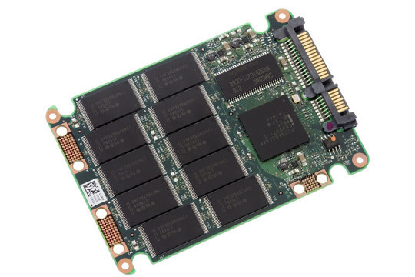

ASP.NET Application State
Live Demo

Slide 33
Session State
Storage of information at user level (different one for each user)
The session is active:
Till the user closes the browser or
A certain period expires (20 minutes for example)
Every session is identified by a unique SessionID
Created at first entry in the site
Transmitted in a cookie by default

Slide 34
Session State (2)
The HttpSessionState dictionary collection is used through HttpContext or Page
To handle events fired when a session is started or ended we use Session_OnStart and Session_OnEnd in the Global.asax file
To deny/restrict access to the session
Session["username"] = "pesho";
string = (string) Session["username"];
<%@ Page EnableSessionState="False" %>
<%@ Page EnableSessionState="ReadOnly" %>

Slide 35
Session Configuration
We can configure various aspects of the session mechanism
Use the sessionState section in Web.config
Example:
<system.web>
<sessionState
cookieless="true" mode="InProc"
timeout="60" cookieName="MySite" />
</system.web>

Slide 36
Session Configuration (2)
Important attributes
Timeout
A period for which the session is active
Mode
Where the session is stored – in the current process, SQL Server, external state server
Cookieless
A session that doesn’t use cookies – the SessionID is sent as a parameter in the URL

Slide 37

ASP.NET Session State
Live Demo

Slide 38
State Management – Recommendations
Use a wrapper class over the session
Put all session data in a property inside this wrapper class
All session data should be serializable
Don’t save too much information in the Session
Don’t save lots of information in the ViewState

Slide 39




Manipulating the HTTP Response Headers

Slide 40
The HTTP Response Headers
HTTP headers are part of the server response
Allow the server to pass additional information about the response
Page content, MIME type, encoding, caching mode, cookies, HTTP response codes, etc.
Provide information about the server to the client Web browser
Accessible from code behind through Response.Headers collection
If the body contents is started to render, headers cannot be modified

Slide 41
Manipulating the HTTP Response Headers
Some widely-used response headers:
HeaderEncoding – sets header encoding
Headers – read only collection of headers
ContentType – MIME type of the output
Expires – numbers of minutes before page cached in browser expires
StatusCode – HTTP status code of the output
AppendHeader() – adds an HTTP header to the output stream

Slide 42
Manipulating the HTTP Response Headers – Example
Downloading image file generated at the server by an ASP.NET page:
Response.Clear();
Bitmap generatedImage = new Bitmap(200, 200);
Graphics gr = Graphics.FromImage(generatedImage);
gr.FillRectangle(Brushes.MediumSeaGreen, 0, 0, 200, 200);
gr.FillPie(Brushes.Yellow, 25, 25,150, 150, 0, 45);
gr.FillPie(Brushes.Green, 25, 25, 150, 150, 45, 315);
Response.ContentType = "image/gif";
generatedImage.Save(
Response.OutputStream,ImageFormat.Gif);

Slide 43

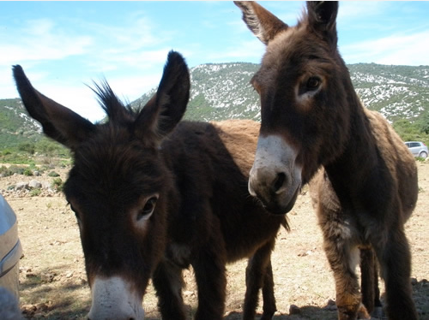

Dynamically Generate Image in ASP.NET Page
Live Demo

Slide 44
ASP.NET State Management
http://academy.telerik.com

Slide 45
Exercises
Create an ASP.NET Web Form, which prints the type of the browser and the client IP address requested .aspx page.
Create a ASP.NET Web Form which appends the input of a text field when a button is clicked in the Session object and then prints it in a <asp:Label> control. Use List<string> to keep all the text lines entered in the page during the session lifetime.
Create two pages that exchange user data with cookies. The first page is a login page. The second one redirects to the first one if the expected cookie is missing. The cookie must expire in 1 minute.

Slide 46
Exercises (2)
In ASPX page holding a TextBox run a JavaScript code that deletes the ViewState hidden field variable in ASPX page. What happens at postback?
Implement a graphical Web counter. It should display as JPEG image the total number of visitors of the requested .aspx page since the start of the Web application. Keep the number of visitors in the Application object. What happens when the Web server is stopped?
Re-implement the previous task to keep the total number of visitors in SQL Server database.

Slide 47
Exercises (3)
* Implement the Tic-Tac-Toe game which allows Internet users to play one against another. Multiple game sessions should be supported to run in parallel. The main page (Default.aspx) should list all games in the application (games now playing, finished games and games waiting for a second player). The user could start a new game or join existing game which has only one player or view who is the winner of any finished game. When starting new game or joining an existing game, the player should enter his or her name. Players who wait for an oponent to join to their game or to enter a valid move should check repeatedly at 1 second.

Slide 48



Free Trainings @ Telerik Academy
"Web Design with HTML 5, CSS 3 and JavaScript" course @ Telerik Academy
html5course.telerik.com
Telerik Software Academy
academy.telerik.com
Telerik Academy @ Facebook
facebook.com/TelerikAcademy
Telerik Software Academy Forums
forums.academy.telerik.com

